Slide 1
BFS and DFS

Slide 2
Consider the graph G which represents the daily flights between cities of some airline, and suppose we want to fly from city A to city J with the minimum number of stops.
In other words, we want the minimum path P from A to J (where edges has length 1).

Slide 3
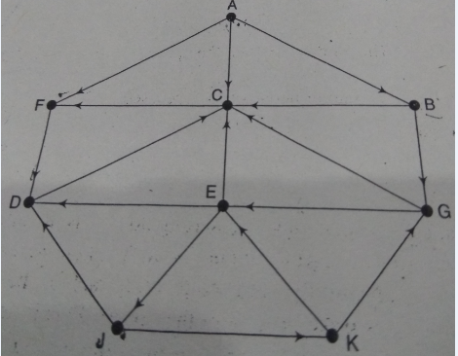

Slide 4
Adjacency lists
A: F,C,B B: G,C C: F D: C E: D,C,J F: D G: C,E J: D,K K: E,G

Slide 5
The minimum path P can be found by usinf BFS beginning at city A and ending when J is encountered.
During the execution of the search, w e will also keep track of the origin of each edge by using an array ORIG together with the array QUEUE.

Slide 6
The steps of our search are as follows:
Initially, add A to queue and add NULL to ORIG as follows:
FRONT=1 QUEUE: A
REAR=1 ORIG: Ø
(b) Remove front element A from QUEUE by setting FRONT=FRONT+1 and add to queue the neighbors of A as follows:
FRONT=2 QUEUE: A, F, C, B
REAR=4 ORIG : Ø, A, A, A
Note that the origin A of each of the three edges is added to ORIG.

Slide 7
c) Remove the front element F from QUEUE by setting FRONT=FRONT+1 and add to QUEUE the neighbors of F as follows:
FRONT=3 QUEUE: A, F, C, B, D
REAR=5 ORIG : Ø, A, A, A ,F
d) Remove the front element C from QUEUE, and add to QUEUE the neighbors of C (which are in the ready state) as follows:
FRONT=4 QUEUE: A, F, C, B, D
REAR=5 ORIG : Ø, A, A, A, F

Slide 8
Note that the neighbor F of C is not added to QUEUE, since F is not in the ready state (because F has already been added to QUEUE)
e) Remove the front element B from QUEUE, and add to QUEUE the neighbors of B (the ones in the ready state) as follows:
FRONT=5 QUEUE: A, F, C, B, D, G
REAR=6 ORIG : Ø, A, A, A, F, B
Note that only G is added to QUEUEU, since the other neighbor, C is not in the ready state.

Slide 9
f) Remove the front element D from QUEUE, and add to QUEUE the neighbors of D (the ones in the ready state) as follows:
FRONT=6 QUEUE: A, F, C, B, D, G
REAR=6 ORIG : Ø, A, A, A, F, B
g) Remove the front element G from the QUEUE and add to QUEUE the neighbors of G(the ones in the ready state) as follows:
FRONT=7 QUEUE: A, F, C, B, D, G, E
REAR=7 ORIG : Ø, A, A, A, F, B, G

Slide 10
h) Remove the front element E from QUEUE the neighbors of E (the ones in the ready state) as follows:
FRONT=8 QUEUE: A, F, C, B, D, G, E, J
REAR=8 ORIG : Ø, A, A, A, F, B, G, E
We stop as soon as J is added to QUEUE, since J is our final destination. We now backtrack from J, using the array ORIG to find the path, Thus J <- E <- G <- B<- A
is the required path P.

Slide 11
Depth First search

Slide 12
Consider the graph G. Suppose we want to find and print all the nodes reachable from node J (including J itself). To do this we can use depth first search of G starting at the node J.
The steps are as follows:
(a) Initially, push J onto the stack as follows:
STACK: J
(b) Pop and print the top element, and then push onto the stack all the neighbors of J (those that are in the ready state) as follows:
Print J STACK: D,K

Slide 13
(c) Pop and print the top element K, and then push onto the stack all the neighbors of K (those that are in the ready state) as follows:
Print K STACK: D,E,G
(d) Pop and print the top element G, and than push onto the stack all the neighbors of G (those in the ready state) as follows:
Print G STACK: D,E,C
Note that only C is pushed onto the stack, since the other neighbor, E is not in the ready state (because E has already been pushed onto the stack).

Slide 14
(e) Pop and print the top element C, and then push onto the stack all the neighbors of C (those in the ready state) as follows:
Print C STACK: D, E, F
(f) Pop and print the top element F, and then push onto the stack all the neighbors of F (those in the ready state) as follows:
Print F STACK: D, E
Note that the only neighbor D of F is not pushed onto the stack, since D is not in the ready state (because D has already been pushed onto the stack)

Slide 15
(g) Pop and print the top element E, and push onto the stack all the neighbors of E(those in the ready state) as follows:
Print E STACK: D
Note that none of three neighbors of E is in the ready state)
(h) Pop and print the top element D, and push onto the stack all the neighbors of D (those are in the ready state) as follows:
Print D STACK:

Slide 16
The stack is now empty, so the depth first search of G starting at J in now complete.
Accordingly, the nodes which were printed
J, K, G, C,F, E, D
are precisely the nodes which are reachable from J.

